Slide 1
Sql and r
By Tim Kim

Slide 2
S.q.l. aka “sequel”
Structured Query Language
SQL is a language that was designed to access relational databases
Relational database is a collection of information that is organized like a table in an excel spreadsheet

Slide 3
Uses of SQL and r
R was made especially for data analysis and graphics
SQL was made especially for Databases
Use SQL to store, query, and manipulate data
- R supports the use of SQL to retrieve data from centrally l. located relational databases.
- it is useful to create, add data, analyze, update data, delete

Slide 4
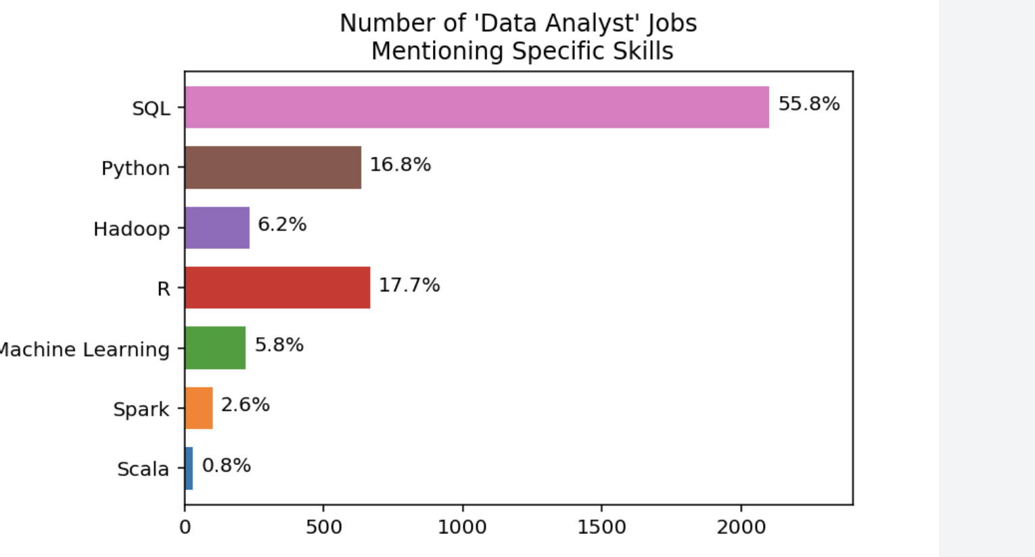
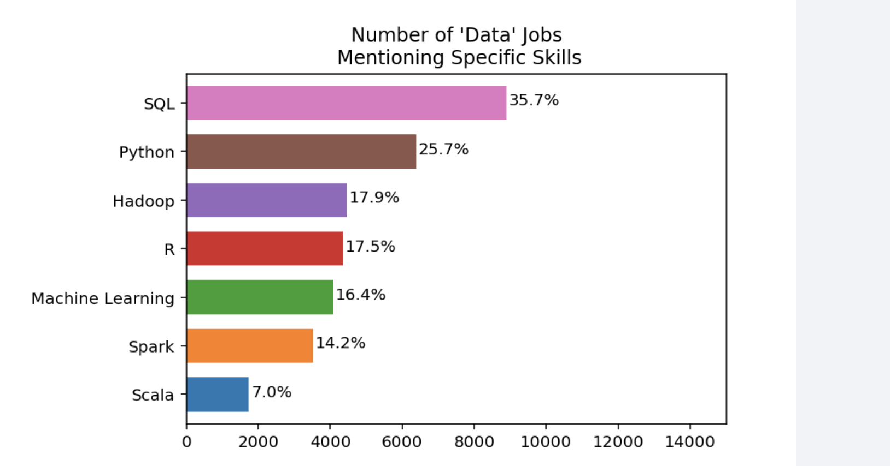
More data
The use of SQL is high in demand so it’s a good idea to learn it for future careers
Most common language that is used by most companies

Slide 5
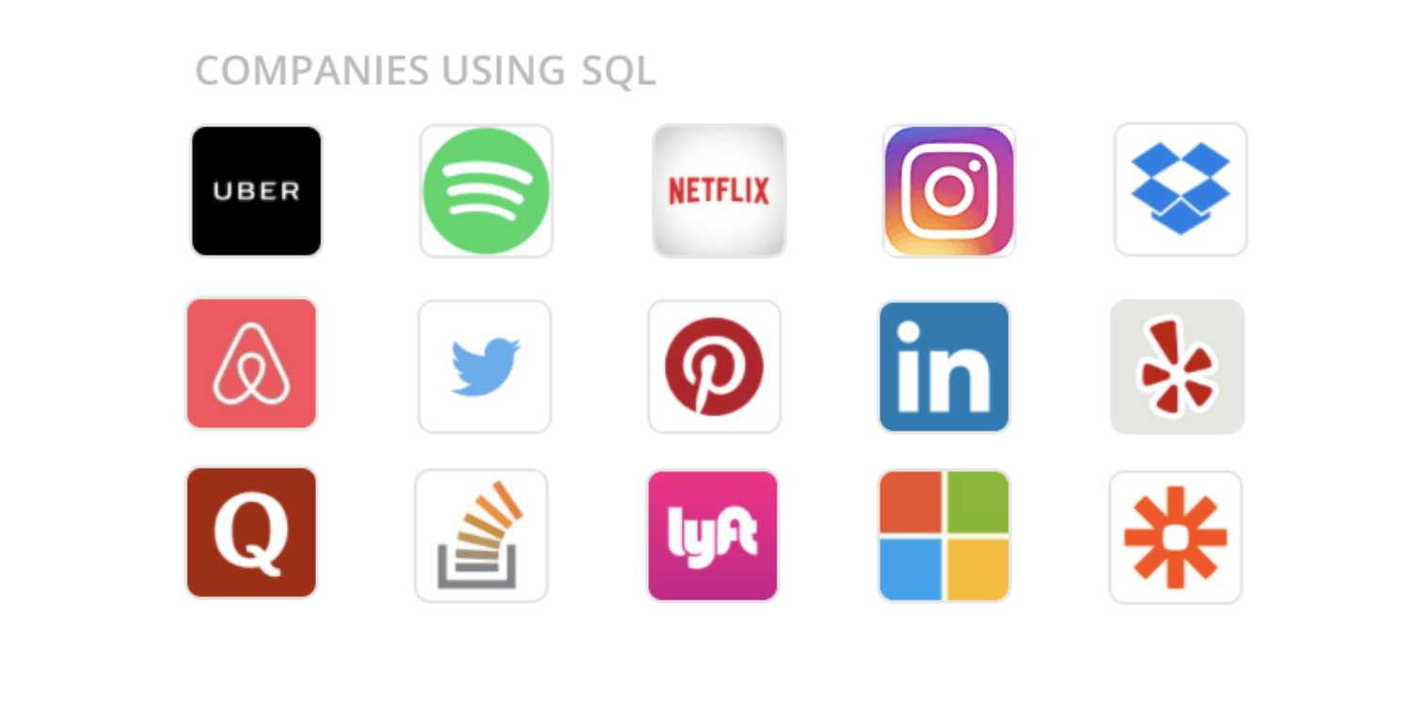
Jobs using sql and r
Data analyst
IT systems analyst
Healthcare data analyst
Data scientist
Data engineer
Quantitative analyst
Data analytics consultant
Project manager
Transportation Logistics Specialist

Slide 6
Works cited
https://www.dataquest.io/course/sql-fundamentals/
https://www.dataquest.io/course/sql-intermediate-r/
https://www.dataquest.io/blog/10-data-analytics-jobs/

